Slide 1
TEAM High School

Slide 2
TEAM High School
Alternative School

Slide 3
TEAM High School
Many High Risk Students

Slide 4
TEAM High School
Accept All Students

Slide 5
TEAM High School
Diploma

Slide 6
TEAM High School
Enrollment Time Varies

Slide 7
TEAM High School
Teacher Hours Vary

Slide 8
TEAM High School
Open Monday-Friday

Slide 9
TEAM High School
Mondays – Optional

Slide 10
TEAM High School
Tuesday – Friday Required

Slide 11
TEAM High School
Required 2 Hours/Day

Slide 12
TEAM High School
APEX Program

Slide 13
TEAM High School
Grading – 70% or Better

Slide 14
TEAM High School
Can Accelerate

Slide 15
TEAM High School
Satisfactory Progress

Slide 16
TEAM High School
Athletics

Slide 17
TEAM High School
Clubs

Slide 18
TEAM High School
Skills Center

Slide 19
TEAM High School
Running Start

Slide 20
TEAM High School
Special Education Services

Slide 21
TEAM High School
Motivated, Dedicated & Responsible

Slide 22
TEAM High School
Parents Tracking Progress

Slide 23
TEAM High School
Our Staff

Slide 24
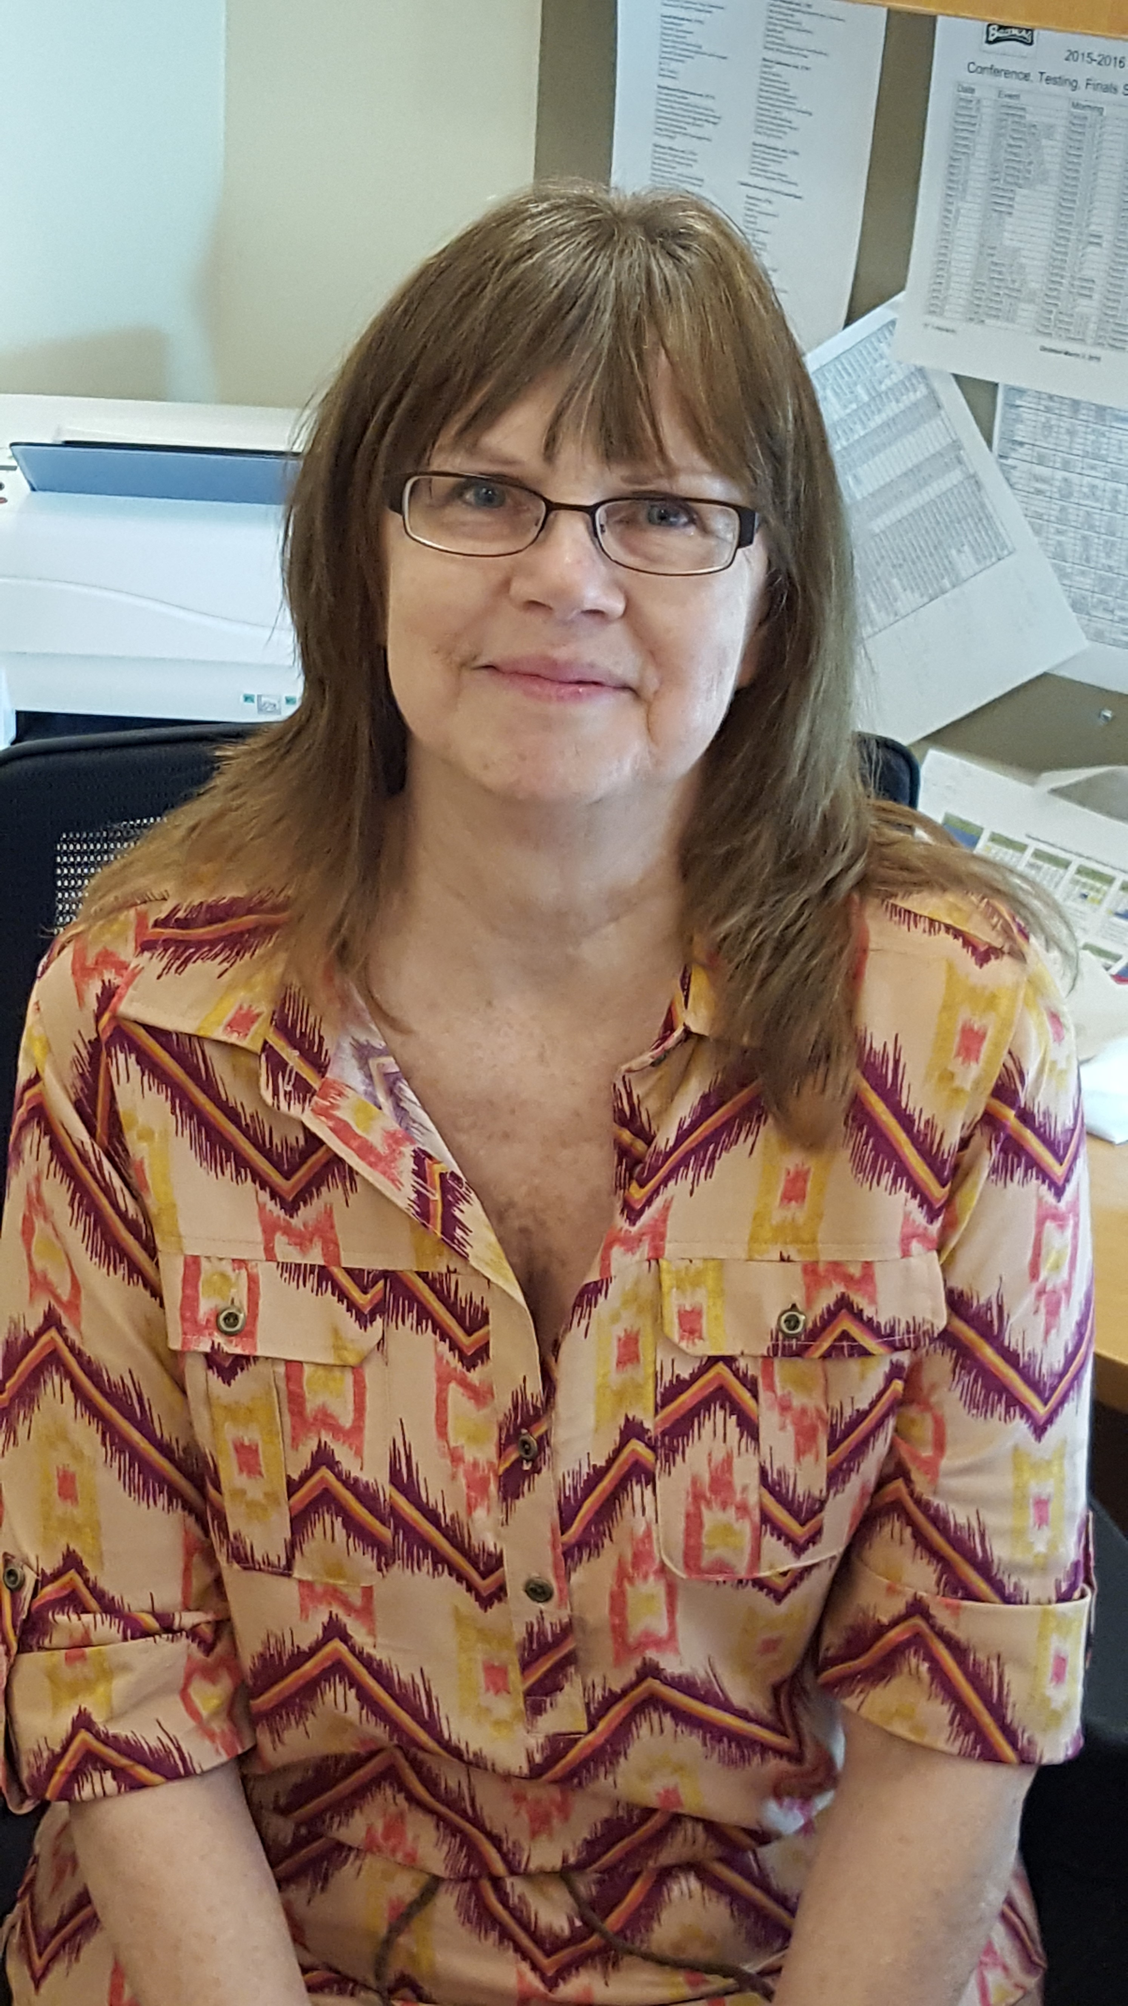
TEAM High School
Registrar – Tish Brand

Slide 25
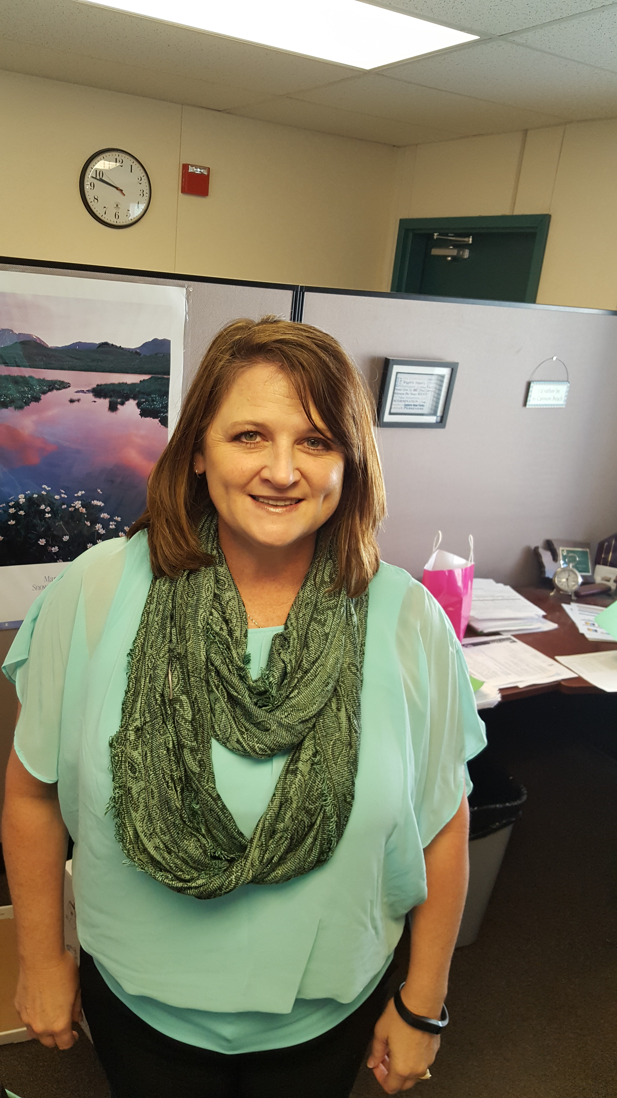
TEAM High School
Bookkeeper – Stacy Brown

Slide 26
TEAM High School
Counselor – Sarah Gray

Slide 27
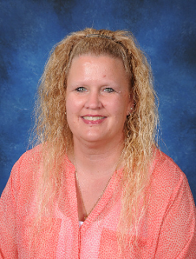
TEAM High School
Sp. Ed. – Jody Flanagan

Slide 28
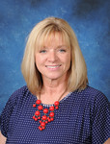
TEAM High School
C.P. – Mary Ann Sturdivan

Slide 29
TEAM High School
Para-Pro – Mary Burnett

Slide 30
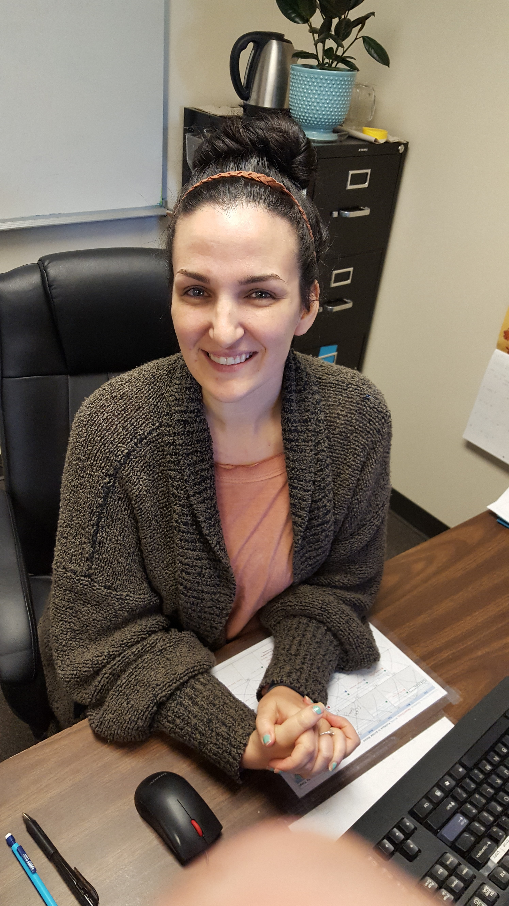
TEAM High School
Teacher – Elizabeth Vallaire

Slide 31
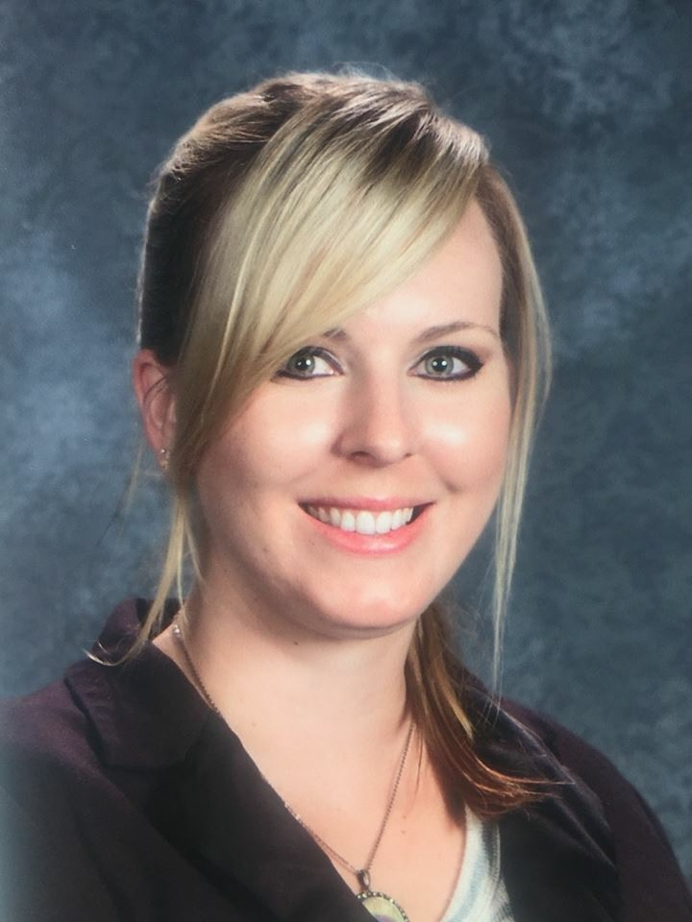
TEAM High School
Teacher – Jillian Jacobs

Slide 32
TEAM High School
Statistics
2012-2013
2013-2014
2014-2015

Slide 33
TEAM High School
Total Students
202

Slide 34
TEAM High School
Choice Students
82

Slide 35
TEAM High School
Still Active
21

Slide 36
TEAM High School
Duration at TEAM

Slide 37
TEAM High School
Withdrawal Reasons

Slide 38
TEAM High School
Graduation

Slide 39
TEAM High School
Questions or Comments

